Slide 1
My Way
Dr. Wendy A. Warr
http://www.warr.com

Slide 2

Moi?

Slide 3
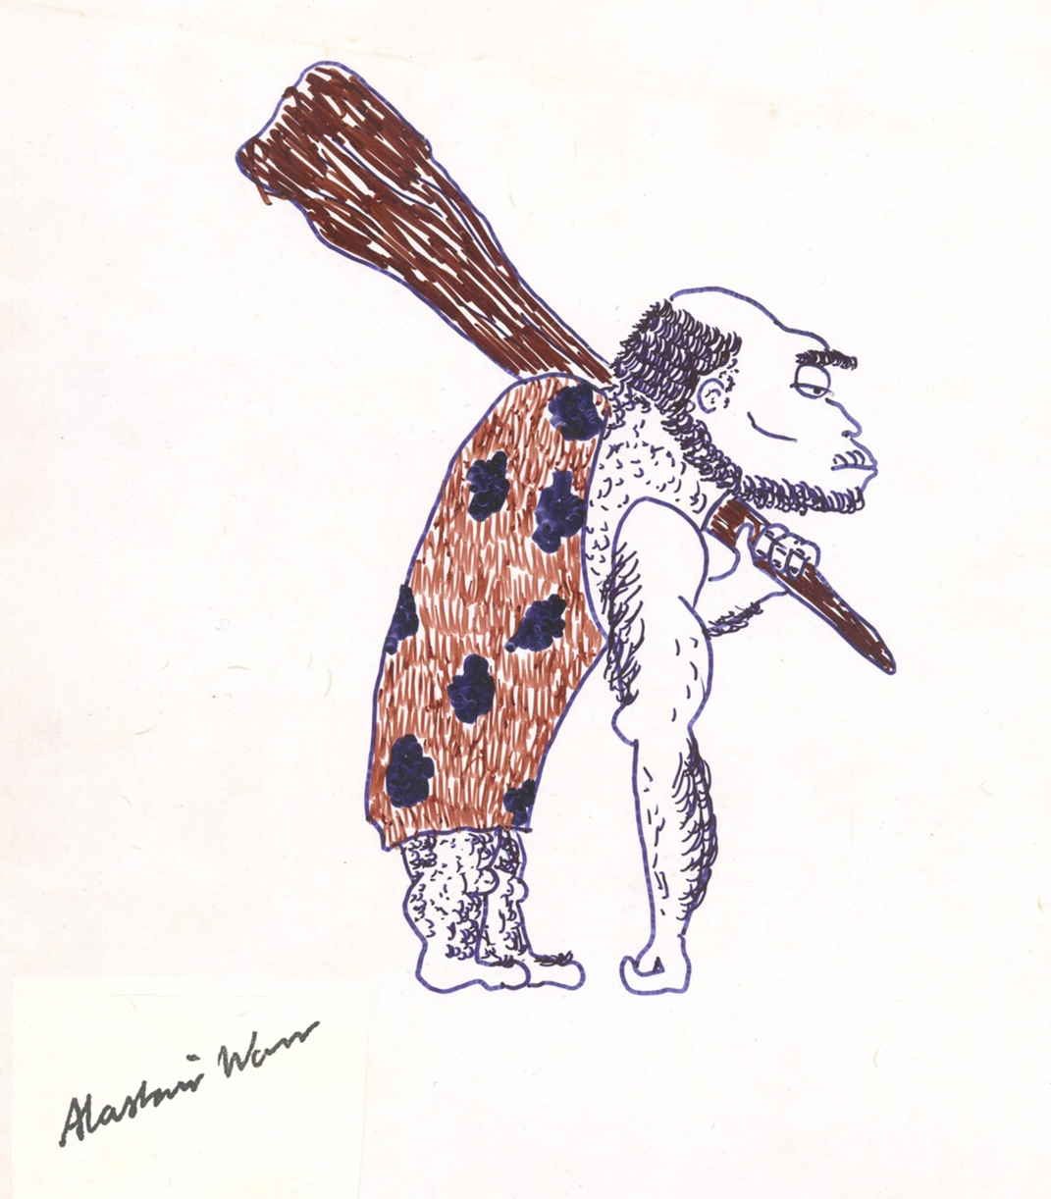
Learning from History

Slide 4
Employment
1968-1970 OU Experimental Information Unit
1970-1972 Robinson Brothers, Research Chemist
1972-1991 ICI Pharmaceuticals
1992-2019 Wendy Warr & Associates

Slide 5
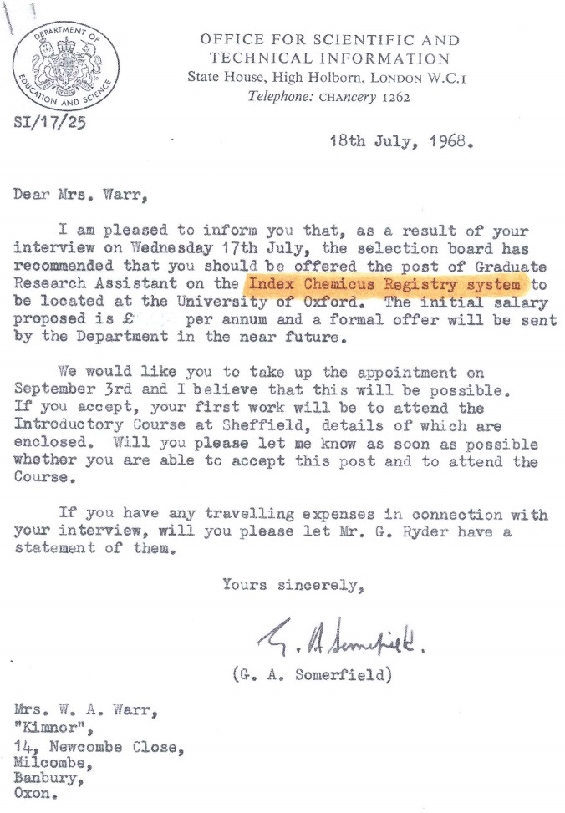
Oxford University Experimental Information Unit

Slide 6
Wiswesser Line Notation
Notes:
NextMove Software has just released an algorithm that interprets WLN for use with the Pistoia Alliance Universal Data Model (UDM) a data exchange format that allows experimental data on chemical reactions to be shared.

Slide 7
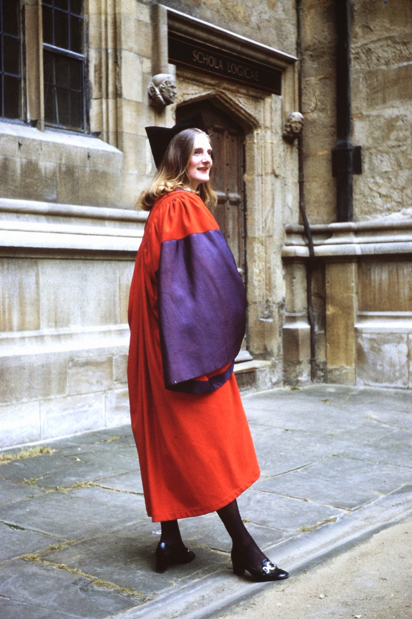
Thanks to WLN and ICRS…
Notes:
After I finished my BA at Oxford, I was offered a job in the newly founded Experimental Information Unit at the University. I spent the summer learning to code structures into Wiswesser Line Notation (WLN) as part of a project to make ISI's Index Chemicus available to UK universities. After a few weeks I admitted that I had really wanted to work for a D. Phil. but had been put off by geographic and financial hurdles. I had married very young and after a year we bought a house in North Oxfordshire. The travelling and other costs were formidable in the bad old days when married women were given reduced grants. To cut a long story short, I did do the D. Phil. but I went on coding WLNs part time. So, when I qualified, I had the option of two alternative careers. For rather more than a year I did research in industry before Ernie Hyde persuaded me to join his team at ICI Pharmaceuticals at Alderley Park in Cheshire. ICI were earlier adopters of WLN and I was one of the few people in the UK who knew the lingo.

Slide 8
ICI Pharmaceuticals
1972-1976 Information Scientist
1976-1979 Senior Information Scientist
and Systems Analyst
1979-1984 Senior Systems Analyst
and Project Manager
1984-1986 Manager, Research Information
1986-1992 Manager, Information Services
Notes:
Punish the innocent, promote the guilty.
Promote to the limit of capability.

Slide 9
ICI Pharmaceuticals
1972-1976 Information Scientist
1976-1979 Senior Information Scientist
and Systems Analyst
1979-1984 Senior Systems Analyst
and Project Manager
1984-1986 Manager, Research Information
1986-1992 Manager, Information Services

Slide 10
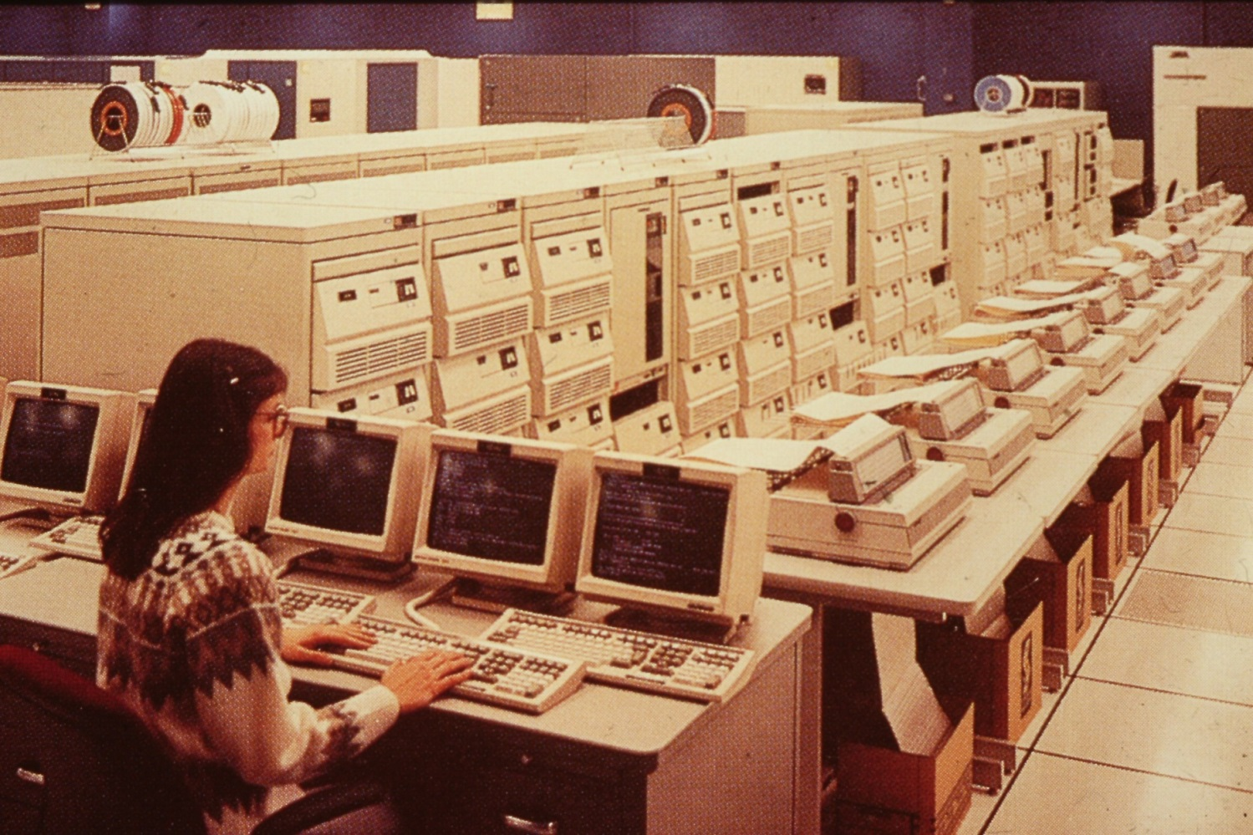
Mainframes
Notes:
The mainframes of the 1960s and 1970s occupied large rooms, consumed huge resources, generated a lot of heat and cost a lot of money.

Slide 11
Mediated Search
Internal data (e.g., CROSSBOW)
External data
Libraries etc.
Online searching (Dialog, Orbit etc.)

Slide 12
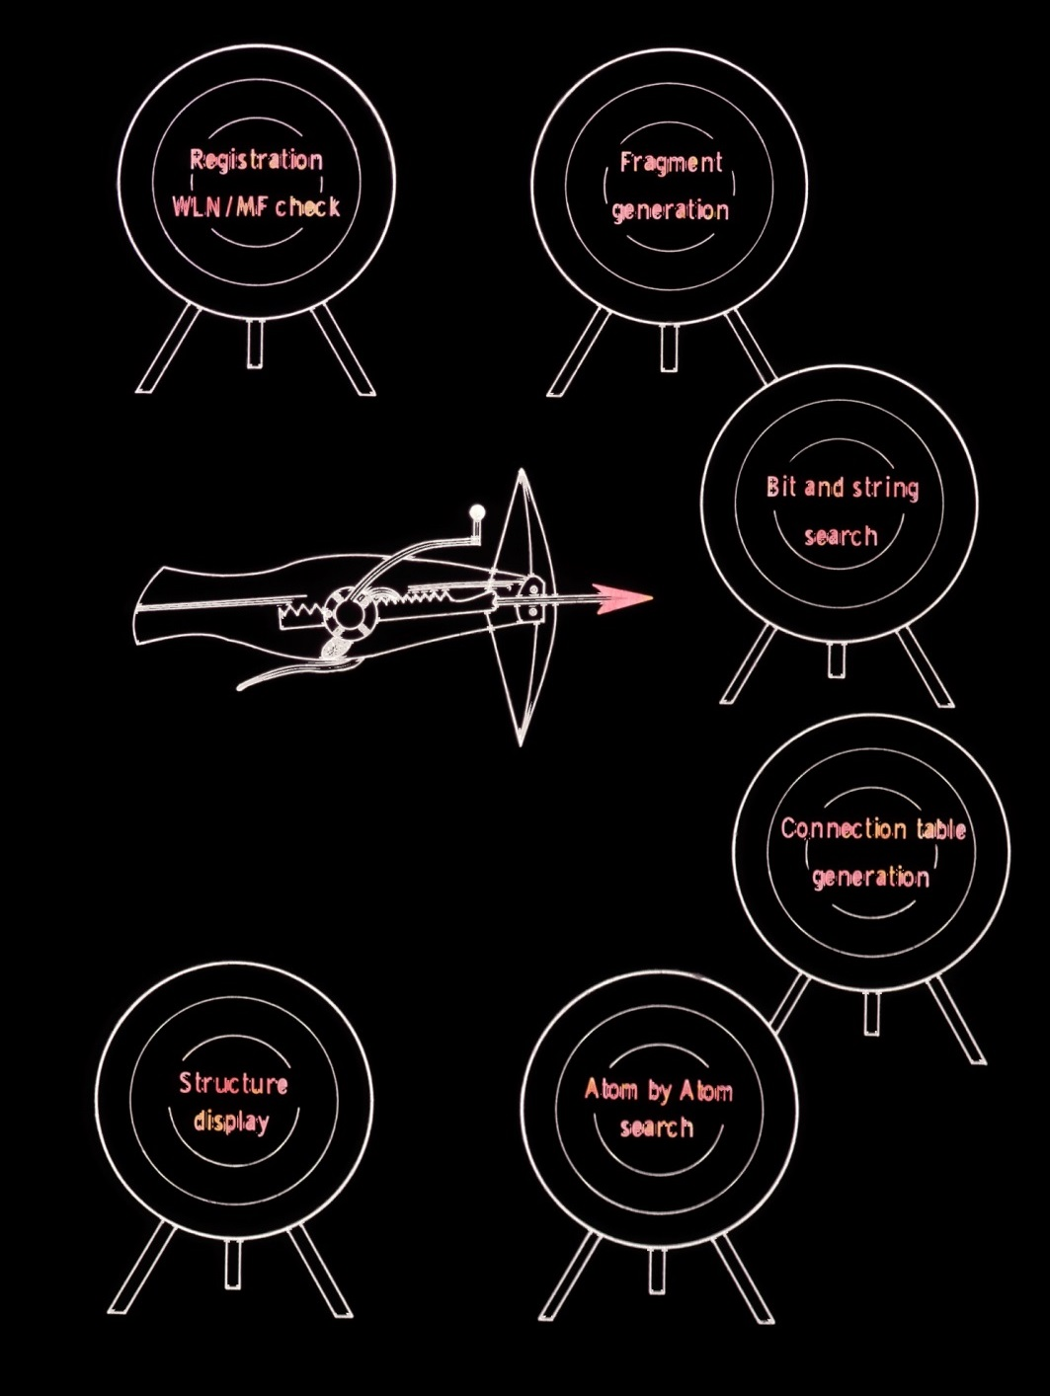
CROSSBOW
Programs
(Computerized Retrieval of
Organic Structures Based on
Wiswesser)

Slide 13
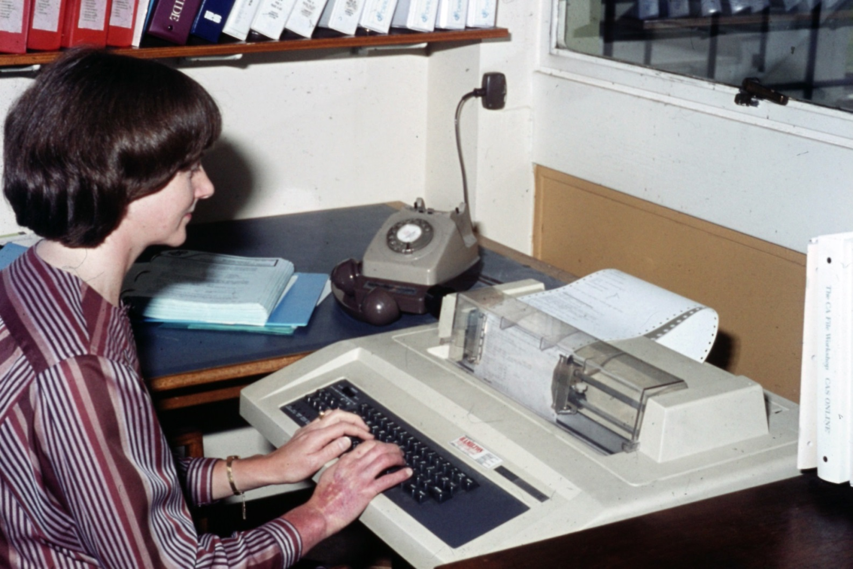
Early online searching
Notes:
Before microcomputers this is how we did online searching, dialing in at maybe 300 baud and using a teleprinter. Back in the 1970s you dialed in and used an acoustic coupler. Note the dial on the phone even in the 1980s.

Slide 14
ICI Pharmaceuticals
1972-1976 Information Scientist
1976-1979 Senior Information Scientist
and Systems Analyst
1979-1984 Senior Systems Analyst
and Project Manager
1984-1986 Manager, Research Information
1986-1992 Manager, Information Services
Notes:
Reactions using WLN. 1976 IBM COBOL. CAOCI. Home Office licenses. Database design. First ACS national meeting 1977.
MDL founded 1979. CAS ONLINE 1980 but no SSS. DARC was used to search EURECAS on Télésystèmes Questel in 1981 before CAS ONLINE could do SSS.

Slide 15
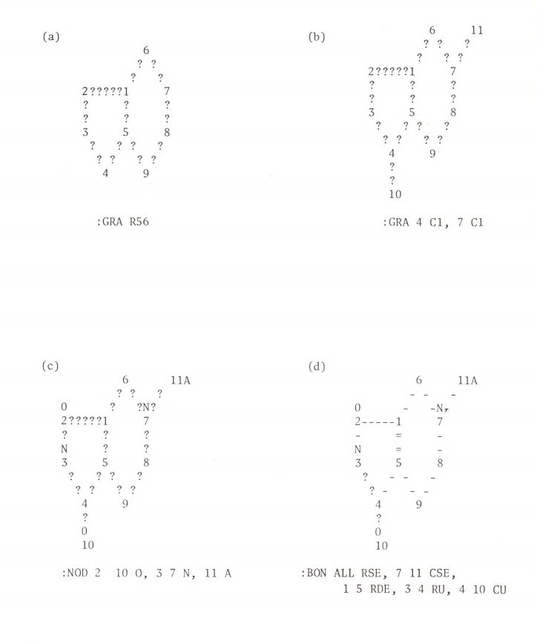
CAS ONLINE Text Structure Query
Notes:
CAS ONLINE 1980

Slide 16
ICI Pharmaceuticals
1972-1976 Information Scientist
1976-1979 Senior Information Scientist
and Systems Analyst
1979-1984 Senior Systems Analyst
and Project Manager
1984-1986 Manager, Research Information
1986-1992 Manager, Information Services
Notes:
1979 MACCS

Slide 17
Chemical Structure Representation
Fragment codes
Derwent, GREMAS, BASIC etc.
Notations
Wiswesser Line Notation (WLN)
Dyson/IUPAC, SMILES, SLN etc.
Connection tables
Warr, W. A. Representation of chemical structures. Wiley Interdiscip. Rev.: Comput. Mol. Sci. 2011, 1(4), 557-579.
Notes:
We’ve drawn the structure in. How does the computer describe and store it?
Names and MFs were early forms of structure representation, with obvious disadvantages.
Fragment codes represent parts of the structure but not how those parts are joined. They can be useful for patents.
Genealogical Retrieval of Magnetic tape Storage
Basel Scientific Information Center. Note that BASIC fragments were used in CAS ONLINE at first.
Line notations such as WLN were popular from the 1960s until about 1982. SMILES survives. SLN (Sybyl Line Notation) is likely to become less important.

Slide 18
Structure Search
Exact search
Substructure search
Similarity search
Superstructure search
Generic (“Markush”) search
Reaction search
3D search

Slide 19
Structure Search Systems
CROSSBOW (1970s)
SANSS (1972-1990)
HTSS
DARC
RS³
S4
CAS REGISTRY MVSSS
SciFinder
MACCS/ISIS
ChemAxon JChem
OpenEye OEChem
etc.
Notes:
CROSSBOW 1960s. First SANSS algorithms published by Feldmann and Heller in 1972. Dubois worked on DARC (Description Acquisition Retrieval Correlation) from 1963. DARC was used to search EURECAS on Télésystèmes Questel in 1981 before CAS ONLINE could do SSS. CAS ONLINE 1980 Peter Bruck’s Hierarchical Tree Substructure Search (HTSS) about 1987 built upon DARC. HTSS was used for Beilstein Online (1988) on ORBIT.
RS3 Oxford Molecular. Bear with me about MVSSS (typo) SciFinder 1995. SciFinder-n late 2016.
Chemical cartridges were a later improvement, e.g. teach a DBMS like Oracle to understand chemistry. Mention Isentris.
SANSS, DARC, Hierarchical Tree Substructure Search (HTSS) and S4 used hierarchical tree structure for the fragment files. Database has to be pre-processed. A comparison of MACCS, DARC, HTSS, and S4 performed in-house at the Beilstein Institute and the CAS Registry MVSSS system was evaluated online on STN International at FIZ Karlsruhe. All systems gave similar results in terms of retrieved hit sets, but S4 dramatically out-performed the other systems in terms of task and elapse times. CAS used PDP-11’s in parallel (from 1989).

Slide 20
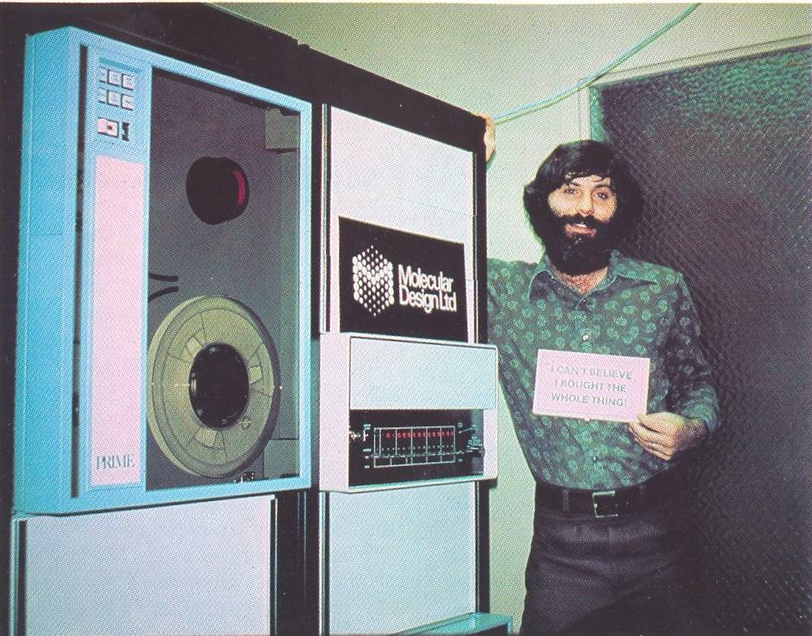
PRIME “Minicomputer”
Notes:
Let’s go back to 1979. Virtual memory.

Slide 21
1984 VAX 11/750
Clock speed 6 MHz
2 Mb memory
134 Mb fixed disk
Two 67 Mb exchangeable disk drives
Shared peripherals
£100,000 (1984 price, now £318,767)
Notes:
VAX virtual address extension 1977-1990. 32-bit architecture. Virtual memory. Replaced the PDP/11. This is the spec for the minicomputer on which ICI first implemented MDL’s MACCS system.

Slide 22
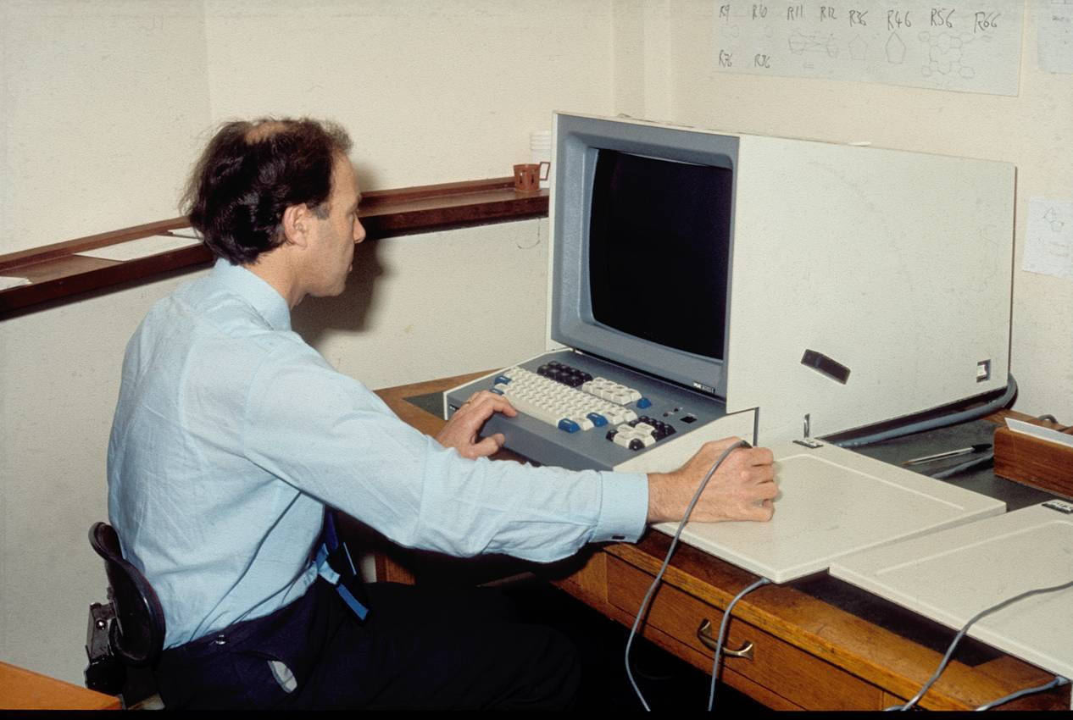
Imlac Terminal
Notes:
Computer graphics goes back to the 1960s. The Imlac company was founded in 1969. Initially, MDL’s MACCS could only be used on expensive Imlac terminals. Note light pen not mouse.

Slide 23
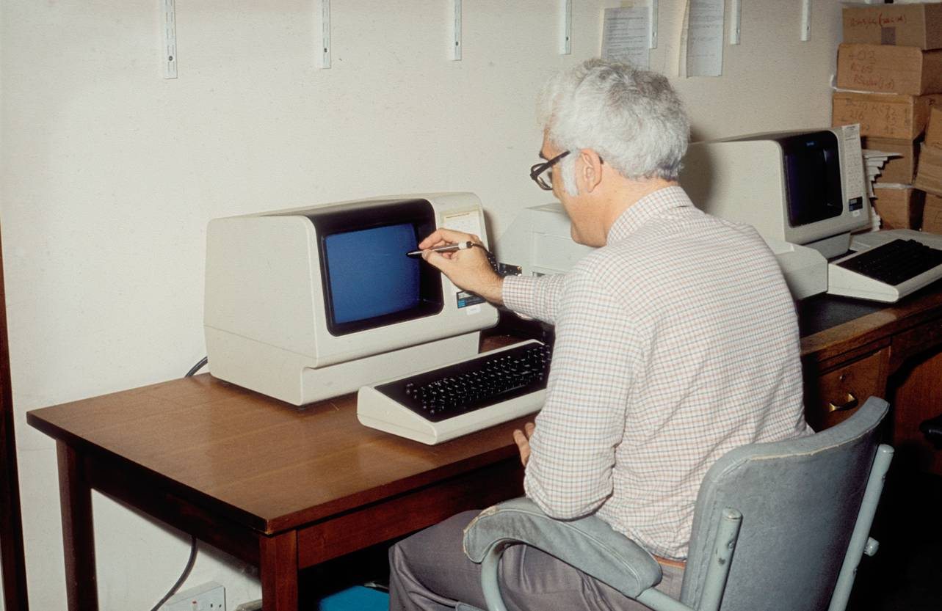
VT640 Terminal
Notes:
The lower price of this terminal made feasible the use of MACCS by end users in ICI. Note the light pen for drawing a structure on the screen.

Slide 24
IBM PC
IBM PC 5150 introduced August 1981
$1,565 - $3,000
(≡ $4,430 - $8,493 in 2019)
IBM BASIC; PC DOS
CPU 4.77 MHz
Memory 16kB to 256 kB
First Macintosh January 1984

Slide 25
ICI Pharmaceuticals
1972-1976 Information Scientist
1976-1979 Senior Information Scientist
and Systems Analyst
1979-1984 Senior Systems Analyst
and Project Manager
1984-1986 Manager, Research Information
1986-1992 Manager, Information Services
Notes:
Union of internal and external information.

Slide 26
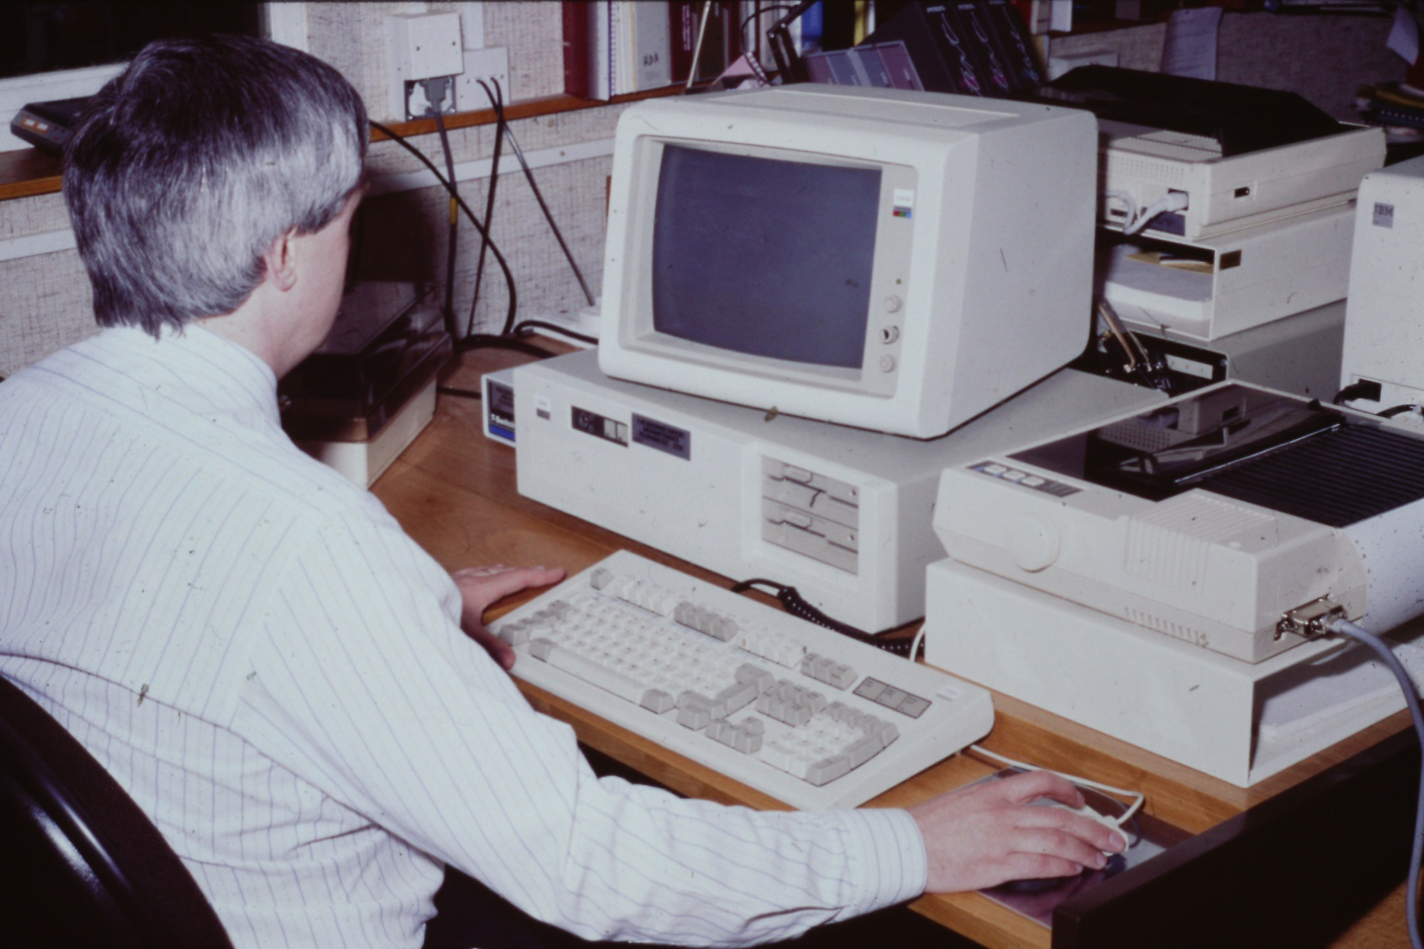
Notes:
An IBM PC with mouse in the mid to late 1980s.

Slide 27
ICI Pharmaceuticals
1972-1976 Information Scientist
1976-1979 Senior Information Scientist
and Systems Analyst
1979-1984 Senior Systems Analyst
and Project Manager
1984-1986 Manager, Research Information
1986-1992 Manager, Information Services

Slide 28
Information Services
Research informatics
Three libraries
Literature and patent searching
Reports collection
Research notebooks
Compound store
Notes:
No ELNs back then

Slide 29
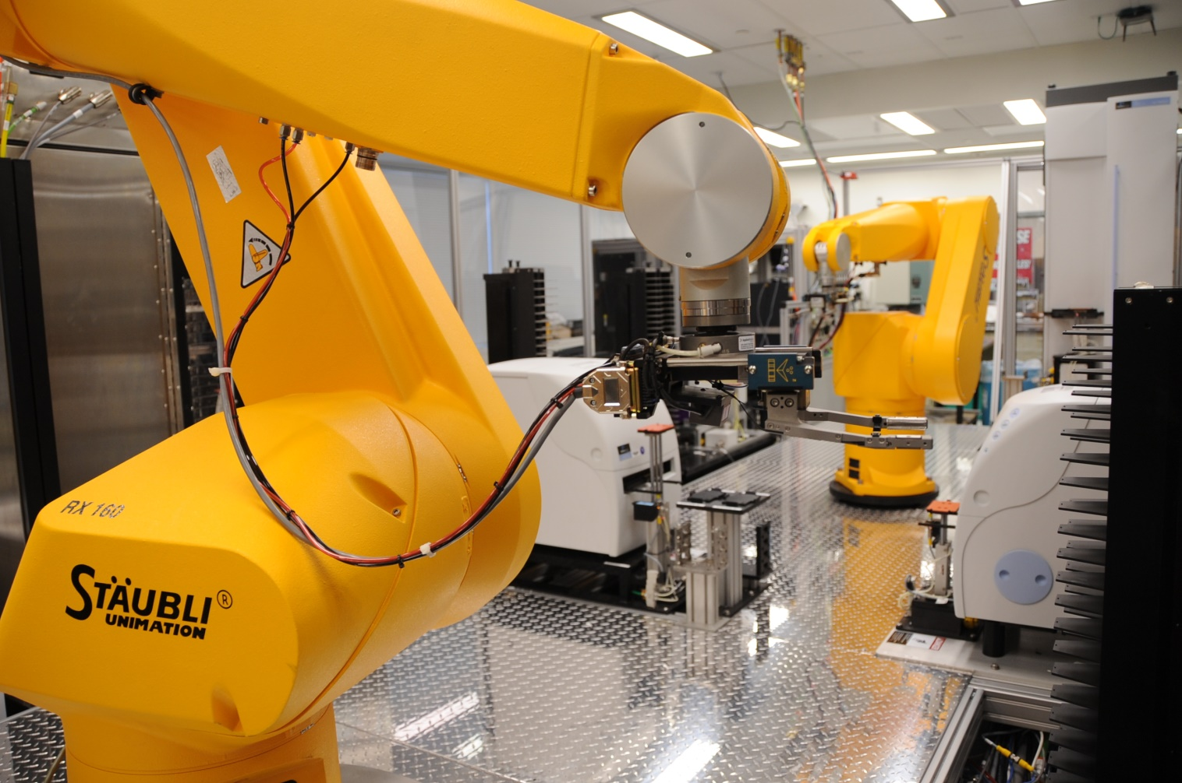
High Throughput Screening
Source: NIH National Human Genome Research Institute

Slide 30
DATA EXPLOSION

Slide 31
Big Data (November 2019)
Screening library 250,000 to 1 million compounds
Corporate compound collection 3 million
SureChEMBL 17 million (2015 figure)
Enamine REAL 700 million
GDB-17: has 164 billion molecules from up to 17 atoms of C, N, O, S, and halogens
Notes:
GDB is Jean-Louis Reymond’s Generated Database

Slide 32
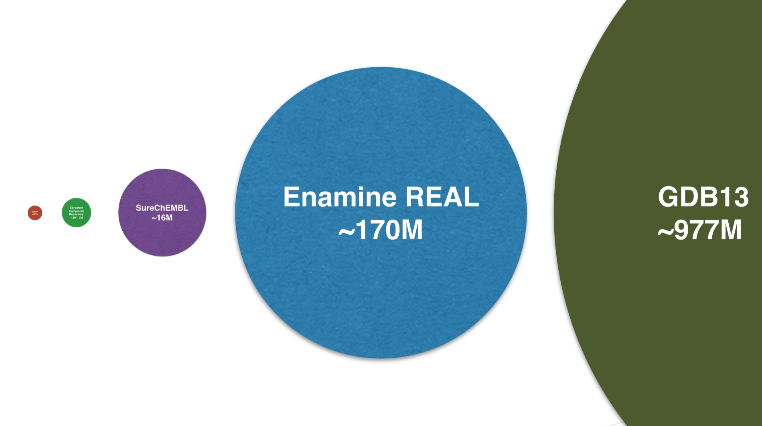
Big Data (2017 Plot)
Source: ChemAxon

Slide 33
Fast Similarity Search
Arthor, NextMove Software
Chemfp, Dalke Scientific Software
FastROCS, OpenEye Scientific Software
FTrees, BioSolveIT
ICFSE, InfoChem
MadFast, ChemAxon
SmallWorld, NextMove Software
etc.
Notes:
Arthor (Merlin’s apprentice) relies heavily on a software architecture. Uses on-the-fly code generation to to create specific machine instructions and a linear-time sort algorithm is used to rank and page results.
chemfp makes cheminformatics fingerprints easy and fast. Chemfp is a set of command-line tools and a Python library for fingerprint generation and high-performance similarity search.
FastROCS uses parallelization. ORION in the cloud.
Ftrees represents a molecule as a tree structure. Each node (FG) carries a profile of physicochemical properties (and pharmacophore) properties of the substructure. Two trees are aligned; there can be gaps, as in sequence alignment. Mapped nodes compared based on property profiles. Code now parallelized for REAL.
MadFast is a ChemAxon product released in December 2016. It is an engine for fast similarity searching. It also provides fast calculation of descriptors such as CFP, ECFP and MACCS-166 fingerprints. Uses efficient in-memory data storage and optimized multi-threaded implementation. NB Daylight used memory
NextMove Software’s SmallWorld is an indexing method. Uses a graph database constructed by the decomposition of molecules one atom at a time. Graph databases: links between web pages form a graph database. SmallWorld uses Graph Edit Distance (GED) but GED is a generalization of calculating Maximum Common Subgraph (MCS), which is computationally hard. SmallWorld does efficient MCS searching of large chemical databases. The index of subgraphs has 69 billion nodes. The sub-linear behavior of SmallWorld’s nearest neighbor calculation makes it faster than fingerprint-based similarity methods.

Slide 34
High Throughput Screening
Source: NIH National Human Genome Research Institute

Slide 35
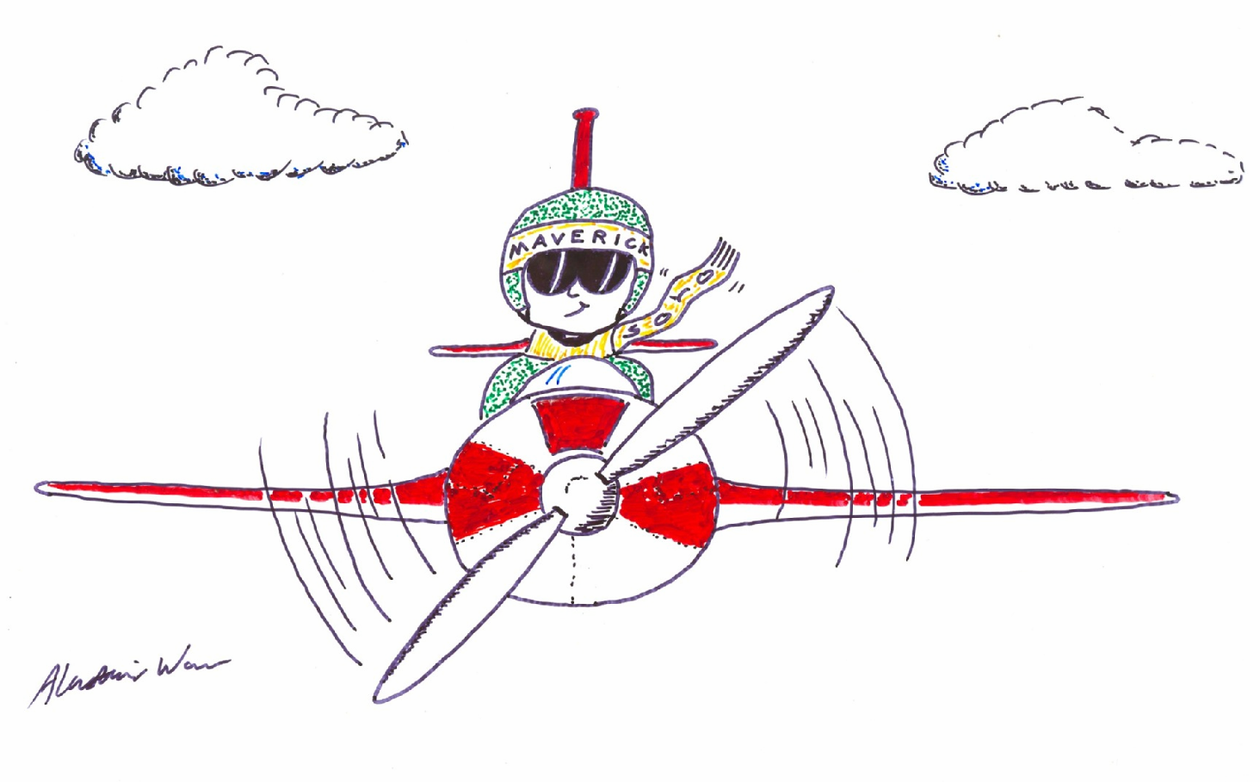
Going it Alone

Slide 36
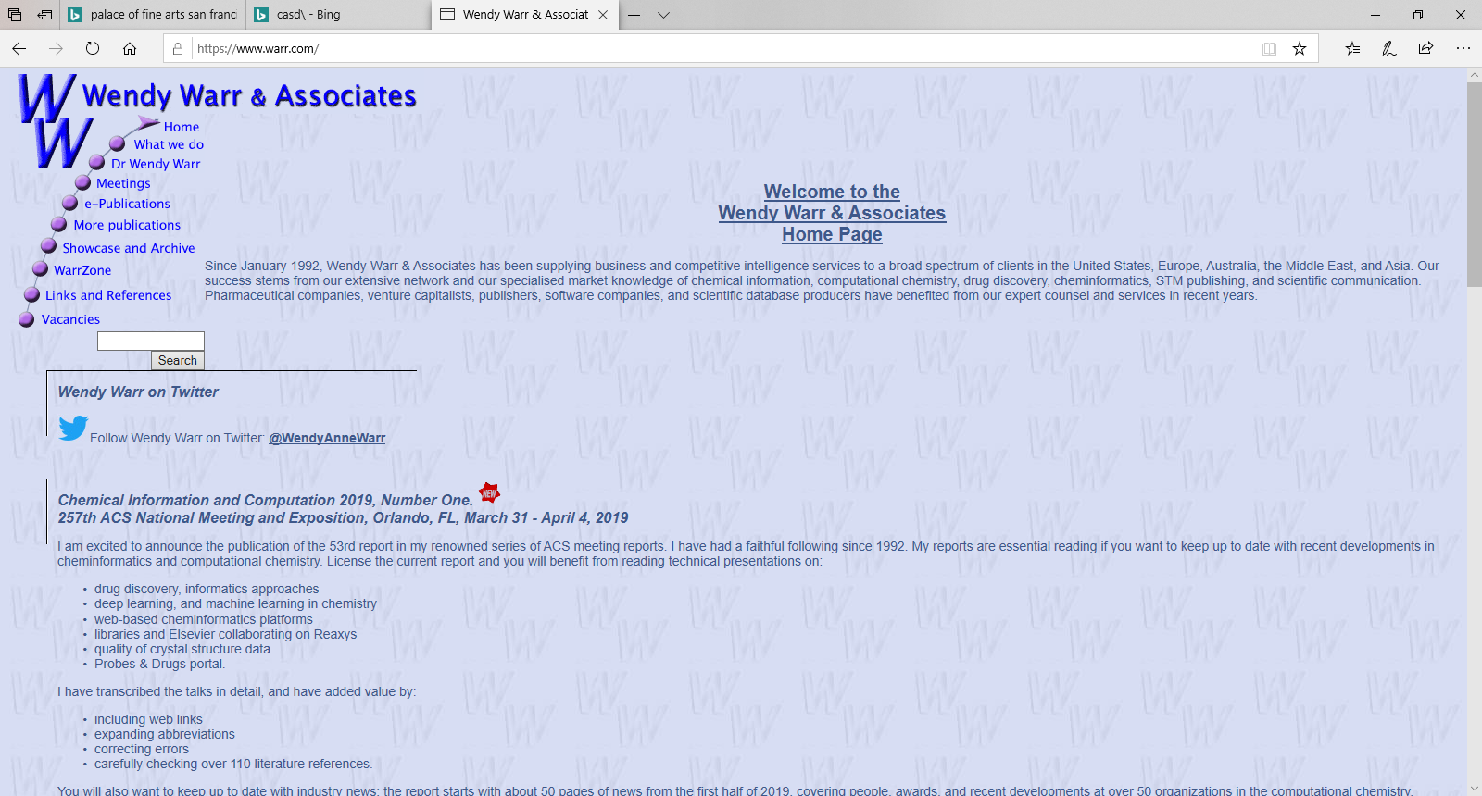
Wendy Warr & Associates

Slide 37
What We Do
Since January 1992, Wendy Warr & Associates has been supplying business and competitive intelligence services to a broad spectrum of clients in the United States, Europe, Australia, the Middle East, and Asia. Our success stems from our extensive network and our specialized knowledge of cheminformatics and high throughput chemistry. Pharmaceutical companies, venture capitalists, publishers, software companies, and scientific database producers have benefited from our expert counsel and services in recent years.

Slide 38
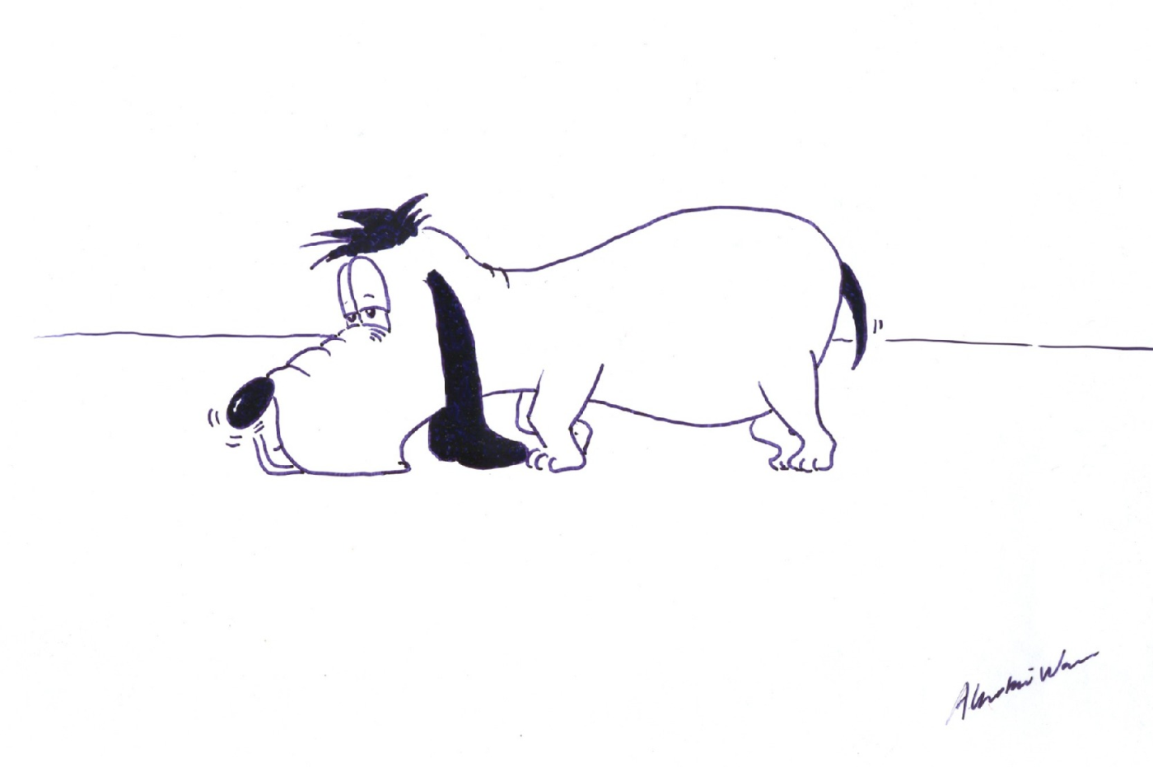
What We Do
Notes:
Competitive intelligence. Nowadays we’d call ourselves management consultants (there is a difference), but we still find things out.

Slide 39
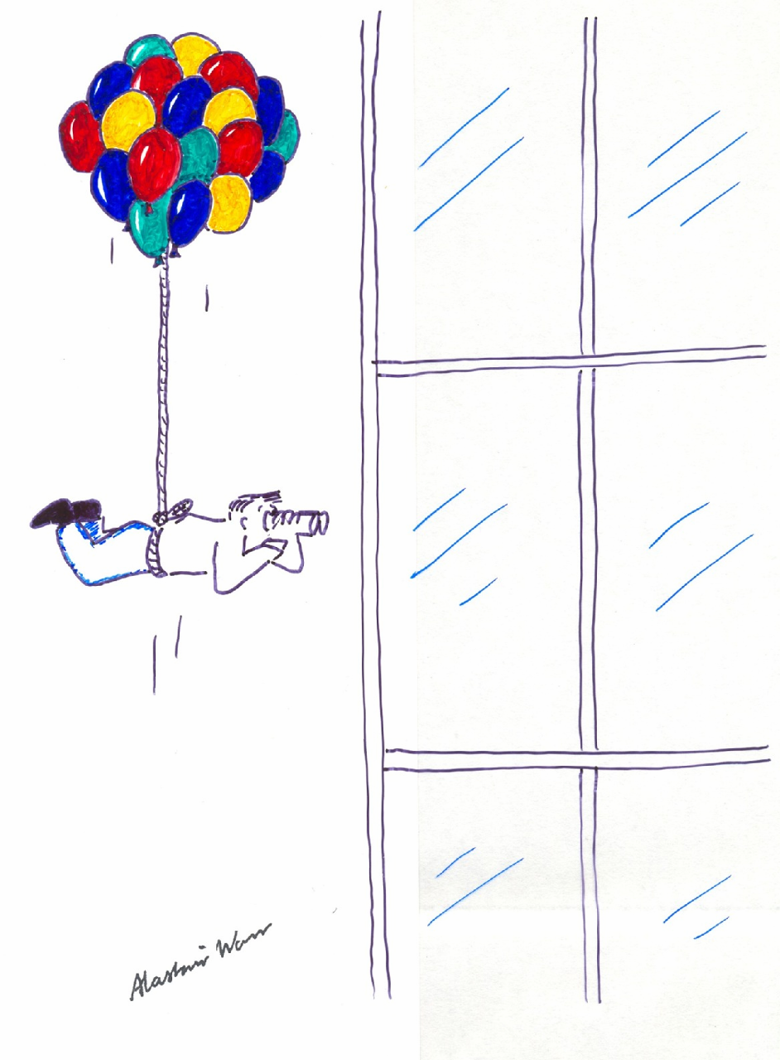
Finding Things Out

Slide 40
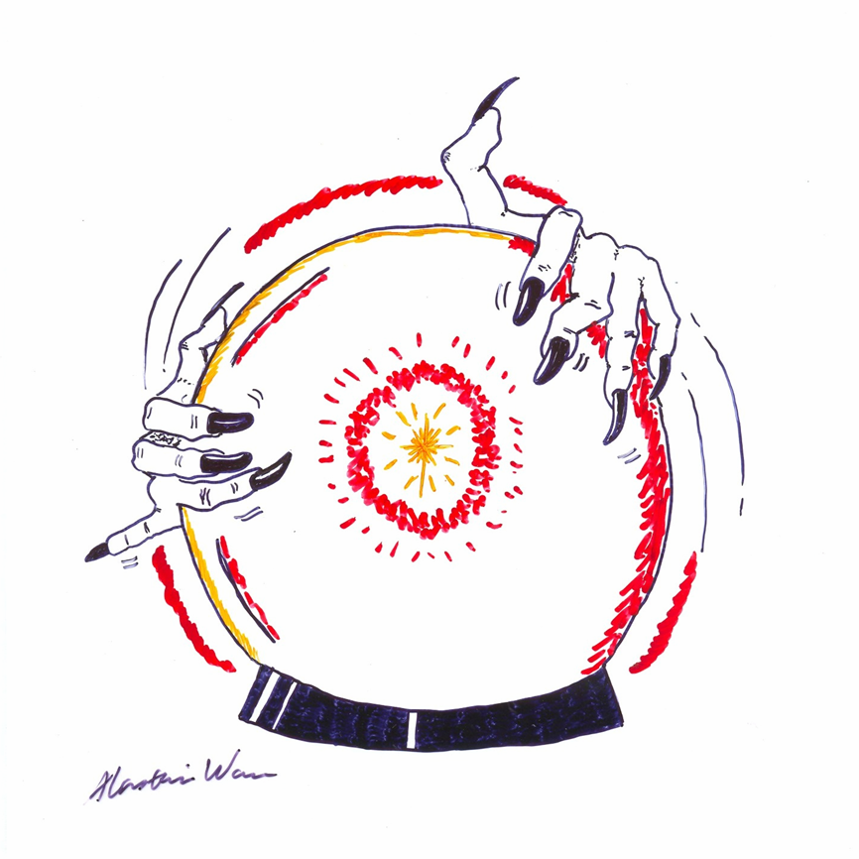
Inventing the Future

Slide 41
Artificial Intelligence and Augmented Intelligence for Automated Investigations for Scientific Discovery (AI3SD)
Notes:
Note augmented intelligence

Slide 42
Expert Systems
Computer-assisted structure elucidation (e.g., DENDRAL 1965)
Computer-aided synthesis design (CASD, e.g., LHASA 1969)

Slide 43
Artificial Intelligence 2019
Machine learning
Data mining
Text mining, NLP, NER, N2S
SureChEMBL, PubChem, IBM Watson
Deep neural networks in QSAR, CASD, drug design, materials science…

Slide 44
AI in Chemistry
Data, data, data
Bad data
Noisy data
Too few negative data
Interpretability

Slide 45
Rules-based Retrosynthesis
Merck Millipore Synthia (Chematica)
InfoChem ICSYNTH
Wiley ChemPlanner

Slide 46
AI Retrosynthesis and Reaction Prediction (1)
Klavs Jensen, Connor Coley et al. MIT
Reaxys
circular fingerprints (RDKIt)
Weisfeiler-Lehman networks
Mark Waller (Munster, Shanghai), Marwin Segler (Munster, BenevolentAI)
Reaxys
circular fingerprints (RDKit)
Monte Carlo tree search, deep NN, symbolic AI (and gated graph NN)
Notes:
Note MIT work on flow chemistry, And optimizing reaction conditions.

Slide 47
AI Retrosynthesis and Reaction Prediction (2)
Schwaller et al. IBM RXN
Reactions from US patents
SMILES/SMARTS
neural machine translation
seq2seq models
SynRoute/SynFini (SRI International)
Reaxys and ACD
ML to generate new reactions
optimal cost routes from network of reactions, using Dijkstra algorithm
Notes:
Mario Latendresse at SRI. Dijkstra Shortest path first algorithm. SynRoute has SynFini digital synthesis protocol

Slide 48
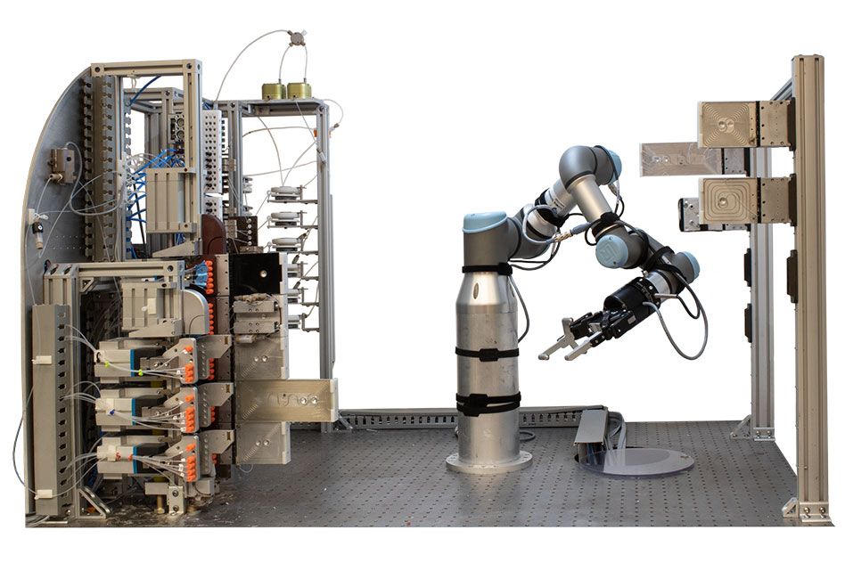
Coley, C. W.; et al. A robotic platform for flow synthesis of organic compounds informed by AI planning. Science 2019, 365 (6453), eaax1566
Image: Connor Coley, Felice Frankel

Slide 49
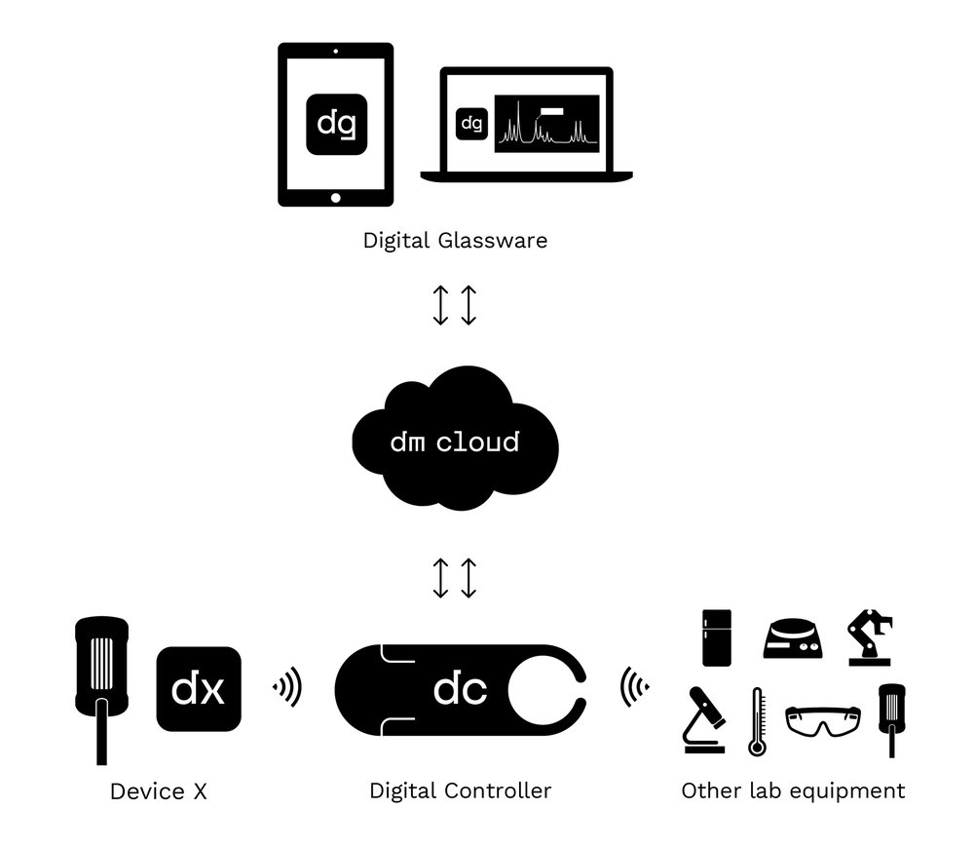
Recordable, Reproducible and Shareable Chemistry
Source: DeepMatter.io

Slide 50
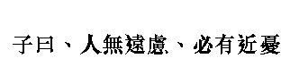
Confucius said: “He who does not take the long view is bound to see trouble in the short term”
Chapter 15 Verse 11
Notes:
"Master said: man not far consider, sure have near trouble“
Men who do not care about the future will soon have trouble
Or The master said: he who does not take the long view is bound to see trouble in the short term.

